Slide 1
Processes

Slide 2
Differentiate
Process
Thread
Process Scheduling

Slide 3
What is a Process?
A process is the execution of a program that allows you to perform the appropriate actions specified in a program
The OS helps you to create, schedule, and terminates the processes which is used by CPU
A process operations can be easily controlled with the help of PCB (Process Control Block)
Consider it as the brain of the process, which contains all the crucial information related to processing like process id, priority, state, and contents

Slide 4
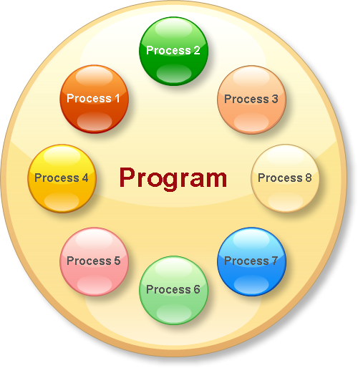
Process Vs Program

Slide 5
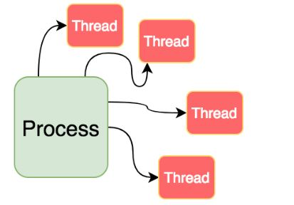
What are Threads?
Thread is an execution unit that is part of a process.
A process can have multiple threads, all executing at the same time

Slide 6

Thread Vs Process

Slide 7
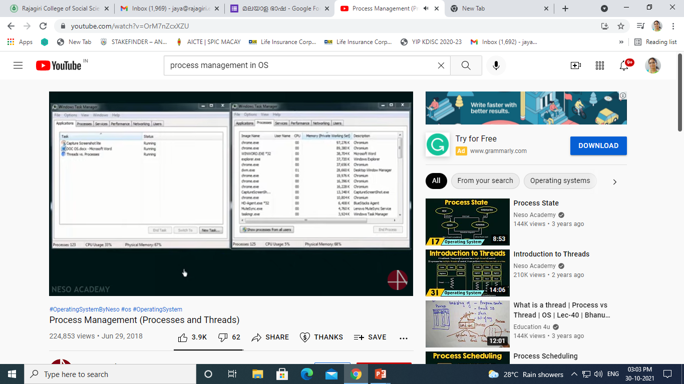

Slide 8
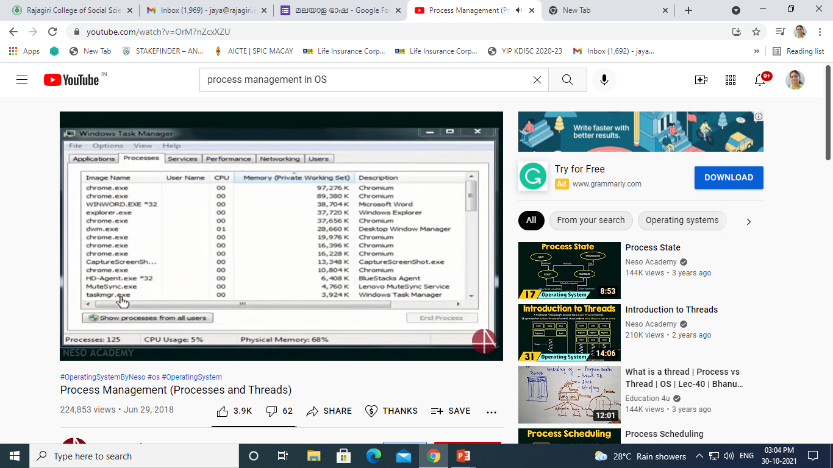

Slide 9
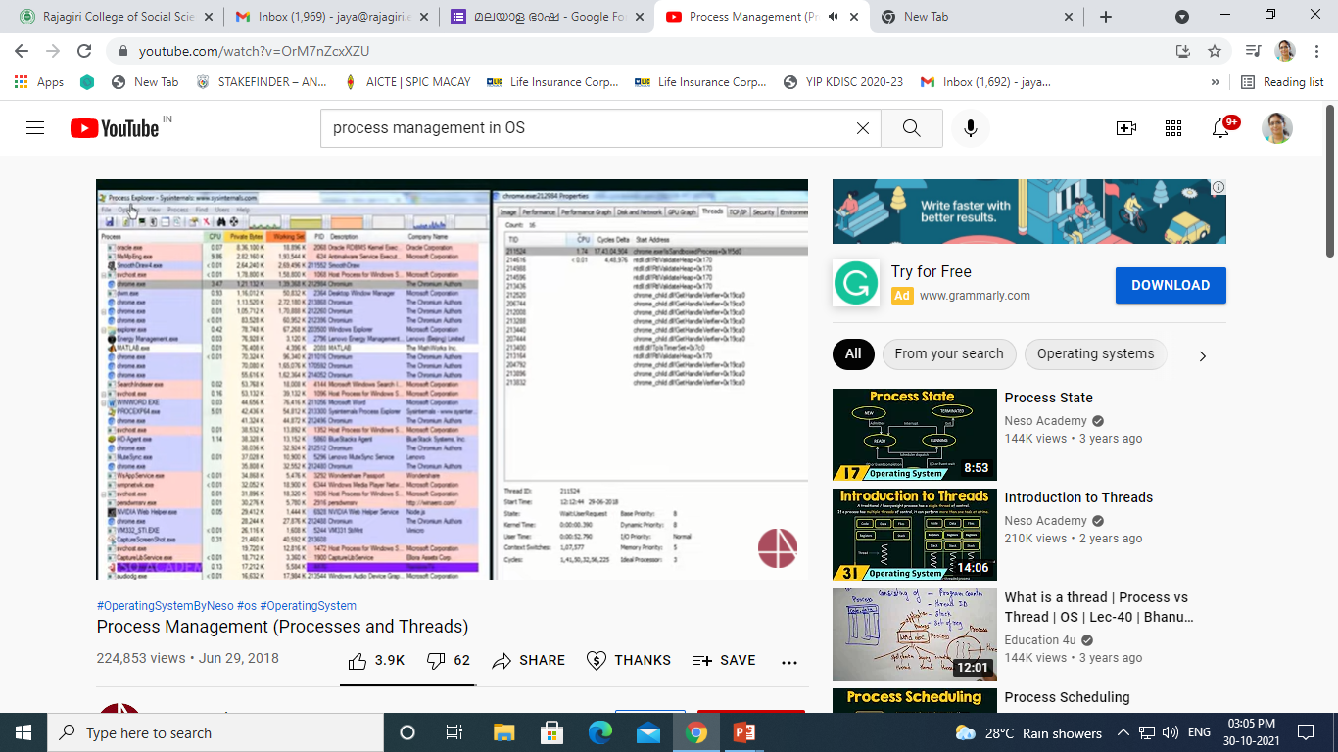

Slide 10
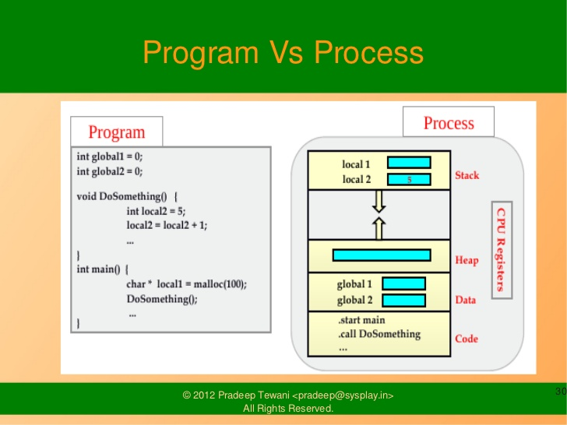

Slide 11
Process Concept
Job and process
Process – a program in execution; process execution must progress in sequential fashion
A process includes:
program counter
stack
data section

Slide 12
Process State
As a process executes, it changes state
new: The process is being created
running: Instructions are being executed
waiting: The process is waiting for some event to occur
ready: The process is waiting to be assigned to a process
terminated: The process has finished execution

Slide 13
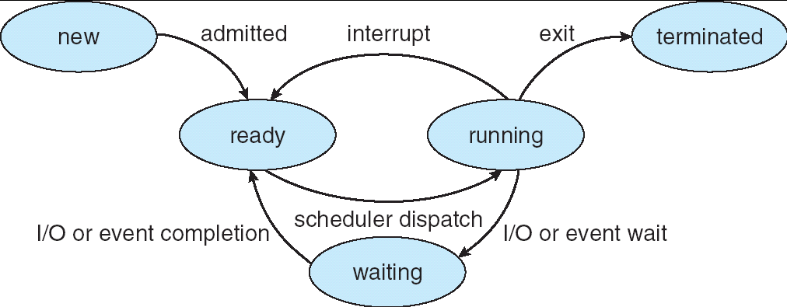
Diagram of Process State

Slide 14
Process Control Block (PCB)
Information associated with each process
Process name
Process state
Program counter
Priority
CPU registers(hardware state)
CPU scheduling information
Memory-management information
Accounting information
I/O status information
File Management information

Slide 15
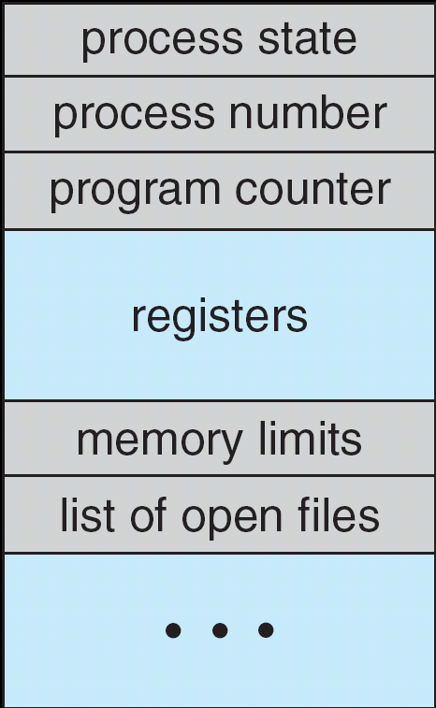
Process Control Block (PCB)

Slide 16
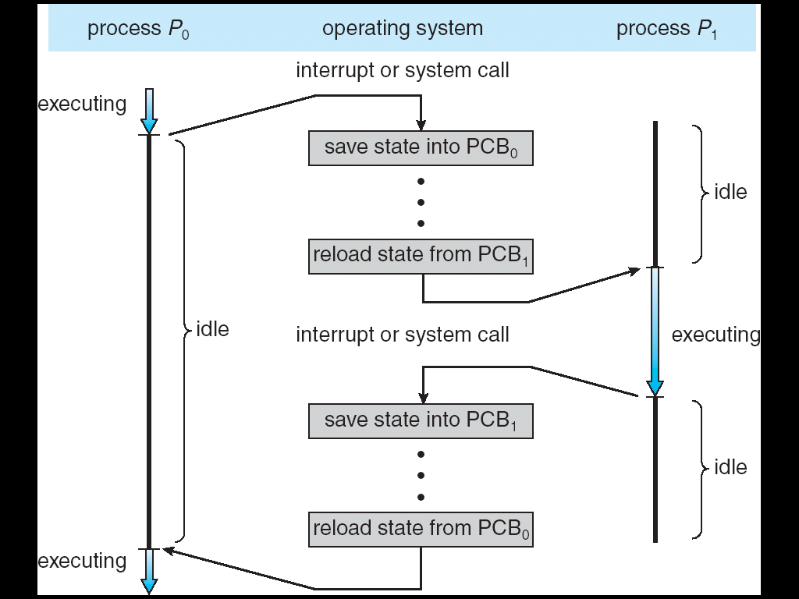
CPU Switch From Process to Process

Slide 17
Process Sceduling
Process Scheduling Queues
Job queue – set of all processes in the system
Ready queue – set of all processes residing in main memory, ready and waiting to execute
Device queues – set of processes waiting for an I/O device
Processes migrate among the various queues

Slide 18
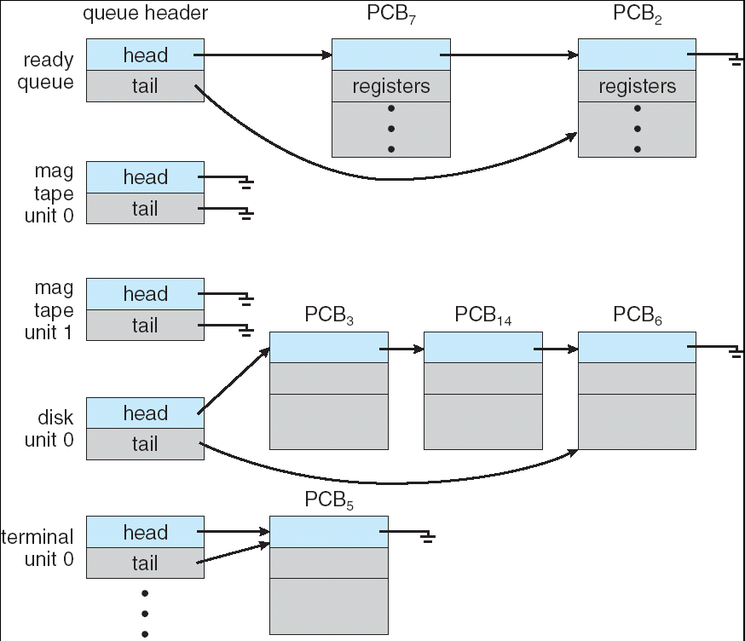
Ready Queue And Various I/O Device Queues

Slide 19
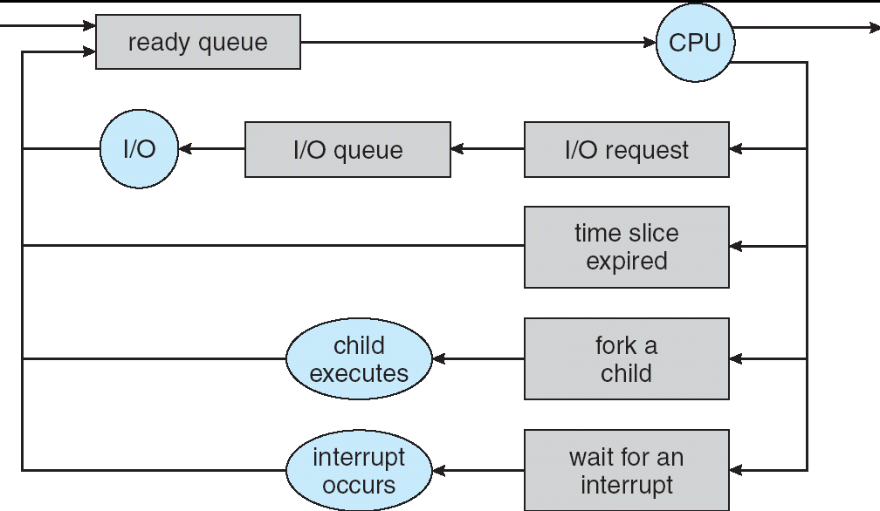
Representation of Process Scheduling

Slide 20
Schedulers
Long-term scheduler (or job scheduler) – selects which processes should be brought into the ready queue
Short-term scheduler (or CPU scheduler) – selects which process should be executed next and allocates CPU
Medium-term scheduler

Slide 21
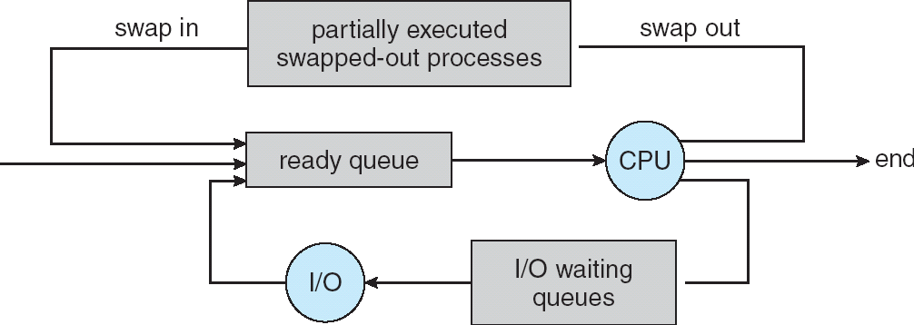
Addition of Medium Term Scheduling

Slide 22
Schedulers (Cont.)
Short-term scheduler is invoked very frequently (milliseconds) ⇒ (must be fast)
Long-term scheduler is invoked very infrequently (seconds, minutes) ⇒ (may be slow)
The long-term scheduler controls the degree of multiprogramming

Slide 23
Context Switch
When CPU switches to another process, the system must save the state of the old process and load the saved state for the new process
Context-switch time is overhead; the system does no useful work while switching

Slide 24
Operations on Processes
Process Creation
Parent process create children processes, which, in turn create other processes, forming a tree of processes
Resource sharing
Parent and children share all resources
Children share subset of parent’s resources
Parent and child share no resources
Execution
Parent and children execute concurrently
Parent waits until children terminate

Slide 25
Process Creation (Cont.)
Address space
Child duplicate of parent
Child has a program loaded into it
UNIX examples
fork system call creates new process
exec system call used after a fork to replace the process’ memory space with a new program

Slide 26
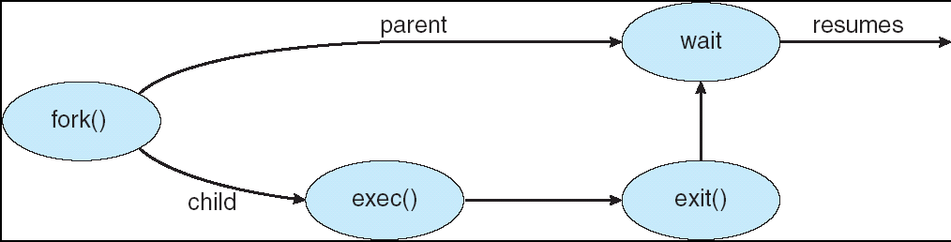
Process Creation

Slide 27
Process Termination
Process executes last statement and asks the operating system to delete it (exit)
Output data from child to parent (via wait)
Process’ resources are deallocated by operating system
Parent may terminate execution of children processes (abort)
Child has exceeded allocated resources
Task assigned to child is no longer required
If parent is exiting
Some operating system do not allow child to continue if its parent terminates
All children terminated - cascading termination

Slide 28
Operating System Services
Create(pid,attr)
Delete(pid)
Abort(pid)
Fork/Join
Suspend(pid)
Resume(pid)
Delay(pid,time)
Get_Attributes(pid,attrset)
Change_Priority(pid, new priority)

Slide 29
CPU Scheduling

Slide 30
Basic Concepts
Maximum CPU utilization obtained with multiprogramming
CPU–I/O Burst Cycle – Process execution consists of a cycle of CPU execution and I/O wait
CPU burst distributionFor I/O bound process: very short CPU bursts
For CPU bound process: few very long CPU bursts

Slide 31
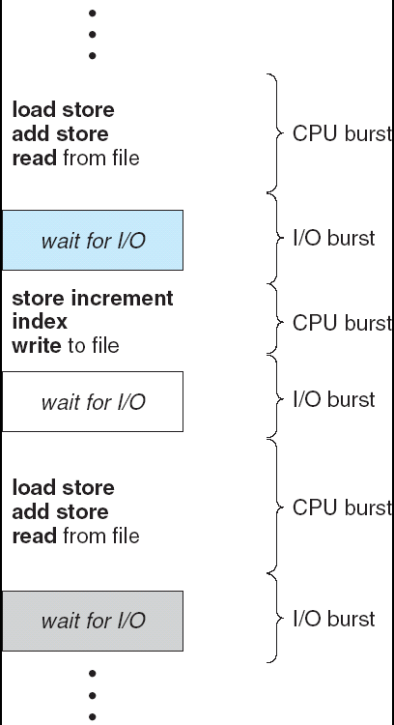
Alternating Sequence of CPU And I/O Bursts

Slide 32
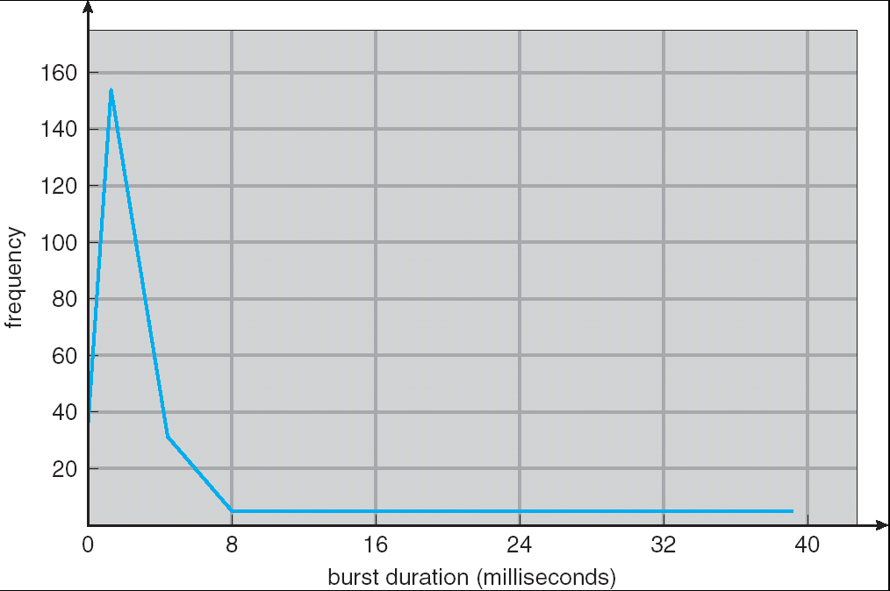
Histogram of CPU-burst Times

Slide 33
CPU Scheduler
Selects from among the processes in memory that are ready to execute, and allocates the CPU to one of them
CPU scheduling decisions may take place when a process:
1. Switches from running to waiting state
2. Switches from running to ready state
3. Switches from waiting to ready
4. Terminates
Scheduling under 1 and 4 is nonpreemptive
All other scheduling is preemptive

Slide 34
Dispatcher
Dispatcher module gives control of the CPU to the process selected by the short-term scheduler; this involves:
switching context
switching to user mode
jumping to the proper location in the user program to restart that program
Dispatch latency – time it takes for the dispatcher to stop one process and start another running

Slide 35
Scheduling Criteria
CPU utilization – keep the CPU as busy as possible
Throughput – # of processes that complete their execution per time unit
Turnaround time – amount of time to execute a particular process
Waiting time – amount of time a process has been waiting in the ready queue
Response time – amount of time it takes from when a request was submitted until the first response is produced, not output (for time-sharing environment)

Slide 36
Optimization Criteria
Max CPU utilization
Max throughput
Min turnaround time
Min waiting time
Min response time

Slide 37
Scheduling Algorithms

Slide 38
First Come First Serve (FCFS)
The process that requests the CPU is allocated the CPU first.
Easy implementation
Using FIFO Queue

Slide 39
First-Come, First-Served (FCFS) Scheduling
Process Burst Time
P₁ 24
P₂ 3
P₃ 3
Suppose that the processes arrive in the order: P₁ , P₂ , P₃ The Gantt Chart for the schedule is:
Waiting time for P₁ = 0; P₂ = 24; P₃ = 27
Average waiting time: (0 + 24 + 27)/3 = 17
P₁
P₂
P₃
0
24
27
30

Slide 40
FCFS Scheduling (Cont.)
Suppose that the processes arrive in the order
P₂ , P₃ , P₁
The Gantt chart for the schedule is:
Waiting time for P₁ = 6; P₂ = 0; P₃ = 3
Average waiting time: (6 + 0 + 3)/3 = 3
Much better than previous case
Convoy effect short process behind long process
P₂
P₃
P₁
0
3
6
30

Slide 41
Shortest-Job-First (SJR) Scheduling
Associate with each process the length of its next CPU burst. Use these lengths to schedule the process with the shortest time
Two schemes:
nonpreemptive – once CPU given to the process it cannot be preempted until completes its CPU burst
preemptive – if a new process arrives with CPU burst length less than remaining time of current executing process, preempt. This scheme is know as the Shortest-Remaining-Time-First (SRTF)
SJF is optimal – gives minimum average waiting time for a given set of processes

Slide 42
Example of Non-Preemptive SJF
Process Arrival Time Burst Time
P₁ 0.0 7
P₂ 2.0 4
P₃ 4.0 1
P₄ 5.0 4
SJF (non-preemptive)
Average waiting time = (0 + 6 + 3 + 7)/4 = 4
P₁
P₃
P₂
P₄
0
3
7
8
12
16

Slide 43
Example of Preemptive SJF
Process Arrival Time Burst Time
P₁ 0.0 7
P₂ 2.0 4
P₃ 4.0 1
P₄ 5.0 4
SJF (preemptive)
Average waiting time = (9 + 1 + 0 +2)/4 = 3
P₁
P₂
P₃
P₂
P₄
P₁
0
2
4
5
7
11
16

Slide 44
Priority Scheduling
A priority number (integer) is associated with each process
The CPU is allocated to the process with the highest priority (smallest integer ≡ highest priority)
Preemptive
nonpreemptive
SJF is a priority scheduling where priority is the predicted next CPU burst time
Problem ≡ Starvation – low priority processes may never execute

Slide 45
Priority Scheduling- Preemptive

Slide 46
Priority Scheduling- Non Preemptive

Slide 47
Round Robin (RR)
Each process gets a small unit of CPU time (time quantum), usually 10-100 milliseconds. After this time has elapsed, the process is preempted and added to the end of the ready queue.
If there are n processes in the ready queue and the time quantum is q, then each process gets 1/n of the CPU time in chunks of at most q time units at once.
No process waits more than (n-1)q time units.

Slide 48
Example of RR with Time Quantum = 20
Process Burst Time
P₁ 53
P₂ 17
P₃ 68
P₄ 24
The Gantt chart is:
P₁
P₂
P₃
P₄
P₁
P₃
P₄
P₁
P₃
P₃
0
20
37
57
77
97
117
121
134
154
162

Slide 50
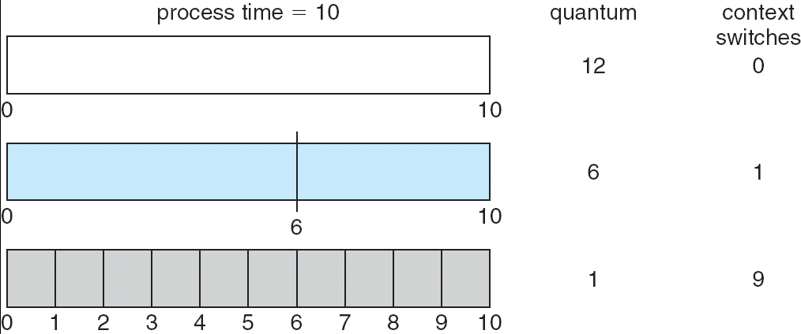
Time Quantum and Context Switch Time

Slide 51
Multilevel Queue
Ready queue is partitioned into separate queues: foreground (interactive) background (batch)
Each queue has its own scheduling algorithm
foreground – RR
background – FCFS
Scheduling must be done between the queues
Fixed priority scheduling; (i.e., serve all from foreground then from background). Possibility of starvation.
Time slice – each queue gets a certain amount of CPU time which it can schedule amongst its processes; i.e., 80% to foreground in RR
20% to background in FCFS

Slide 52
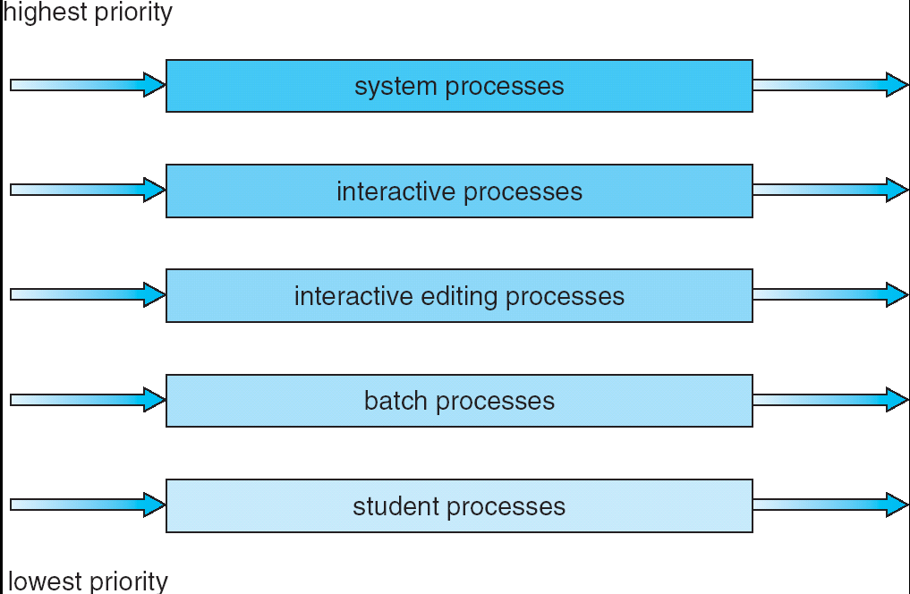
Multilevel Queue Scheduling

Slide 53
Multilevel Feedback Queue
A process can move between the various queues; aging can be implemented this way
Multilevel-feedback-queue scheduler defined by the following parameters:
number of queues
scheduling algorithms for each queue
method used to determine when to upgrade a process
method used to determine when to demote a process
method used to determine which queue a process will enter when that process needs service

Slide 54
Example of Multilevel Feedback Queue
Three queues:
Q₀ – RR with time quantum 8 milliseconds
Q₁ – RR time quantum 16 milliseconds
Q₂ – FCFS
Scheduling
A new job enters queue Q₀ which is served FCFS. When it gains CPU, job receives 8 milliseconds. If it does not finish in 8 milliseconds, job is moved to queue Q₁.
At Q₁ job is again served FCFS and receives 16 additional milliseconds. If it still does not complete, it is preempted and moved to queue Q₂.

Slide 55
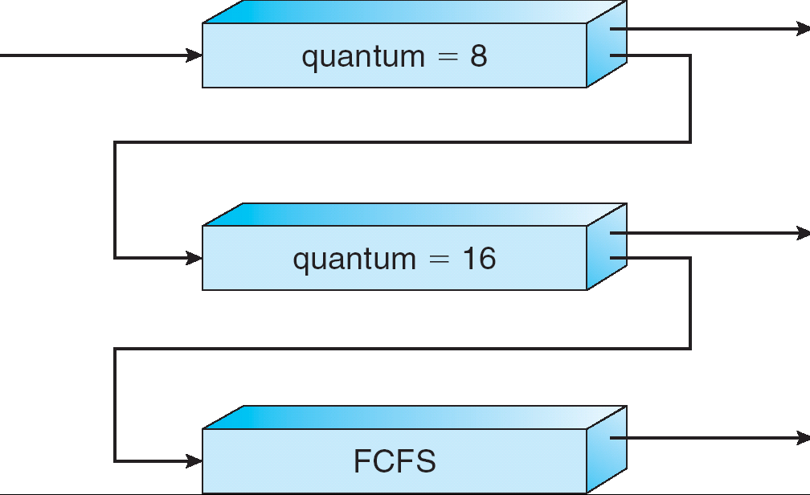
Multilevel Feedback Queues

Slide 56
Operating System
Inter-process synchronization

Slide 58
Processes
Independent process cannot affect or be affected by the execution of another process
Cooperating process can affect or be affected by the execution of another process
Advantages of process cooperation
Information sharing
Computation speed-up
Modularity
Convenience

Slide 60
Interprocess Communication (IPC)
Mechanism for processes to communicate and to synchronize their actions
Message system – processes communicate with each other without resorting to shared variables
IPC facility provides two operations:
send(message) – message size fixed or variable
receive(message)
If P and Q wish to communicate, they need to:
establish a communication link between them
exchange messages via send/receive
Implementation of communication link
physical (e.g., shared memory, hardware bus)
logical (e.g., logical properties)

Slide 61
Direct Communication
Processes must name each other explicitly:
send (P, message) – send a message to process P
receive(Q, message) – receive a message from process Q
Properties of communication link
Links are established automatically
A link is associated with exactly one pair of communicating processes
Between each pair there exists exactly one link
The link may be unidirectional, but is usually bi-directional

Slide 63
Indirect Communication
Messages are directed and received from mailboxes (also referred to as ports)
Each mailbox has a unique id
Processes can communicate only if they share a mailbox
Properties of communication link
Link established only if processes share a common mailbox
A link may be associated with many processes
Each pair of processes may share several communication links
Link may be unidirectional or bi-directional

Slide 64
Indirect Communication
Operations
create a new mailbox
send and receive messages through mailbox
destroy a mailbox
Primitives are defined as:
send(A, message) – send a message to mailbox A
receive(A, message) – receive a message from mailbox A

Slide 65
Indirect Communication
Mailbox sharing
P₁, P₂, and P₃ share mailbox A
P₁, sends; P₂ and P₃ receive
Who gets the message?
Solutions
Allow a link to be associated with at most two processes
Allow only one process at a time to execute a receive operation
Allow the system to select arbitrarily the receiver. Sender is notified who the receiver was.

Slide 67
Synchronization
Message passing may be either blocking or non-blocking
Blocking is considered synchronous
Blocking send has the sender block until the message is received
Blocking receive has the receiver block until a message is available
Non-blocking is considered asynchronous
Non-blocking send has the sender send the message and continue
Non-blocking receive has the receiver receive a valid message or null

Slide 68
Buffering
Queue of messages attached to the link; implemented in one of three ways
1. Zero capacity – 0 messages Sender must wait for receiver
2. Bounded capacity – finite length of n messages Sender must wait if link full
3. Unbounded capacity – infinite length Sender never waits

Slide 69
Client-Server Communication
Sockets
Remote Procedure Calls
Remote Method Invocation (Java)

Slide 70
Sockets
A socket is defined as an endpoint for communication
Concatenation of IP address and port
The socket 161.25.19.8:1625 refers to port 1625 on host 161.25.19.8
Communication consists between a pair of sockets

Slide 71
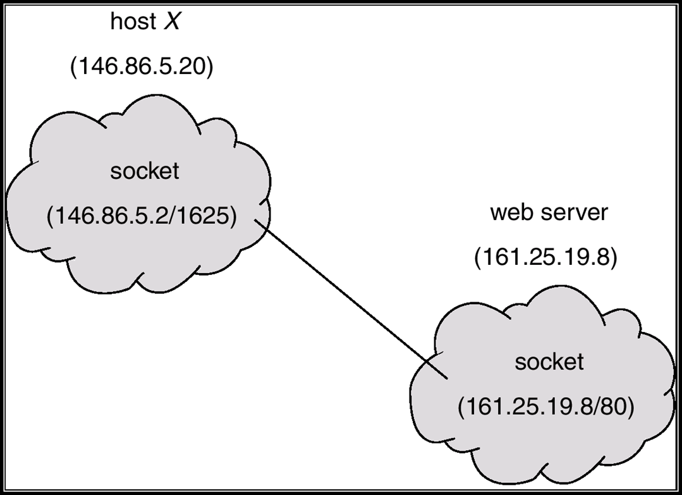
Socket Communication

Slide 72
Remote Procedure Calls
Remote procedure call (RPC) abstracts procedure calls between processes on networked systems.
Stubs – client-side proxy for the actual procedure on the server.
The client-side stub locates the server and marshalls the parameters.
The server-side stub receives this message, unpacks the marshalled parameters, and peforms the procedure on the server.

Slide 73
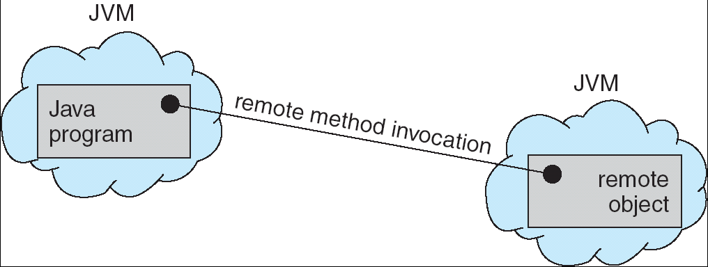
Remote Method Invocation
Remote Method Invocation (RMI) is a Java mechanism similar to RPCs.
RMI allows a Java program on one machine to invoke a method on a remote object.

Slide 74
Producer-Consumer Problem
Paradigm for cooperating processes, producer process produces information that is consumed by a consumer process
Example: a print program produces characters that are consumed by printer driver
To run concurrently
unbounded-buffer places no practical limit on the size of the buffer
bounded-buffer assumes that there is a fixed buffer size

Slide 76
Bounded-Buffer – Shared-Memory Solution
Shared data
#define BUFFER_SIZE 10
Typedef struct {
. . .
} item;
item buffer[BUFFER_SIZE];
int in = 0;
int out = 0;
Solution is correct, but can only use BUFFER_SIZE-1 elements

Slide 77
Bounded-Buffer – Producer Process
item nextProduced;
while (1) {
while (((in + 1) % BUFFER_SIZE) == out)
; /* do nothing */
buffer[in] = nextProduced;
in = (in + 1) % BUFFER_SIZE;
}

Slide 78
Bounded-Buffer – Consumer Process
item nextConsumed;
while (1) {
while (in == out)
; /* do nothing */
nextConsumed = buffer[out];
out = (out + 1) % BUFFER_SIZE;
}

Slide 79
Consider this execution interleaving with “count = 5” initially:
S0: producer execute register1 = count {register1 = 5} S1: producer execute register1 = register1 + 1 {register1 = 6} S2: consumer execute register2 = count {register2 = 5} S3: consumer execute register2 = register2 - 1 {register2 = 4} S4: producer execute count = register1 {count = 6 } S5: consumer execute count = register2 {count = 4}
The value of count may be either 4 or 6, where the correct result should be 5.

Slide 80
Critical section
Each process has a segment of code called a critical section, in which the process may change common variables, updating a table, writing a file and so on.
Entry section
Exit section
Remainder section
do
{
Critical section
Remainder section
}
while (1);
entry section
Exit section

Slide 81
Solution to Critical-Section Problem
1. Mutual Exclusion - If process P_{i} is executing in its critical section, then no other processes can be executing in their critical sections
2. Progress - If no process is executing in its critical section and there exist some processes that wish to enter their critical section, then the selection of the processes that will enter the critical section next cannot be postponed indefinitely
3. Bounded Waiting - A bound must exist on the number of times that other processes are allowed to enter their critical sections after a process has made a request to enter its critical section and before that request is granted
Assume that each process executes at a nonzero speed
No assumption concerning relative speed of the N processes

Slide 82
Two Process Solution-Algoritm-1
Two processes are numbered P0 and P1. i.e, Pi and Pj
Algorithm 1
A common integer variable turn initialized to 0 or 1. If turn==i Process Pi is allowed to execute in its critical section.
Disadvantage
does not retain the sufficient information about the state of each process.
For Process Pi
do {
while (turn!=i);
CRITICAL SECTION
turn=j;
REMAINDER SECTION
} while(1);

Slide 83
Algorithm-2
For Process pi
do {
flag[i]=true;
while(flag[j]);
CRITICAL SECTION
flag[i]=false;
REMAINDER SECTION
}while(1)
Disadvantage
mutual exclusion is preserved
progress requirement is not met
t0: P0 sets flag[0]=true
t1:P1 sets flag[1]=true
looping fore-ever

Slide 84
Algorithm-3-Peterson’s Solution
Two process solution
The two processes share two variables:
int turn;
Boolean flag[2]
The variable turn indicates whose turn it is to enter the critical section.
The flag array is used to indicate if a process is ready to enter the critical section. flag[i] = true implies that process P_{i} is ready!

Slide 85
Algorithm for Process P_{i}
do {
flag[i] = TRUE;
turn = j;
while ( flag[j] && turn == j);
CRITICAL SECTION
flag[i] = FALSE;
REMAINDER SECTION
} while (TRUE);

Slide 86
Multiple Process Solution
Bakery Algorithm
Data structures used
Boolean choosing[n];
int number[n]
- intialized to false and 0 respectively
Notations used
(a,b)<(c,d) ifa<c or a==c and b<d
Max(a₀,…a_{n-1)} is a number k,such that k>=a_{i} for i=0,…n-1

Slide 87
do
{
Choosing[i]=true;
Number[i]=max(number[0],number[1],…number[n-1])+1;
Choosing[i]=false;
for(j=0;j<n;j++) {
while(choosing[j]);
while(number[j]!=0)&&(number[j],j)<number[i],i));
}
CRITICAL SECTION
number[i]=0;
REMAINDER SECTIION
}while(1);

Slide 88
Synchronization Hardware
Many systems provide hardware support for critical section code
Uniprocessors – could disable interrupts
Currently running code would execute without preemption
Generally too inefficient on multiprocessor systems
Operating systems using this not broadly scalable
Modern machines provide special atomic hardware instructions
Atomic = non-interruptable
Either test memory word and set value
Or swap contents of two memory words

Slide 89
Synchronization Hardware
Either test memory word and set value
the test-and-set instruction is an instruction used to write to a memory location and return its old value as a single atomic (i.e., non-interruptible) operation.
If multiple processes may access the same memory, and if a process is currently performing a test-and-set, no other process may begin another test-and-set until the first process is done.
Or swap contents of two memory words
swap a special instruction that atomically compares the contents of a memory location to a given value and, if they are the same, modifies the contents of that memory location to a given new value. The result of the operation must indicate whether it performed the substitution

Slide 90
Lock variable

Slide 91
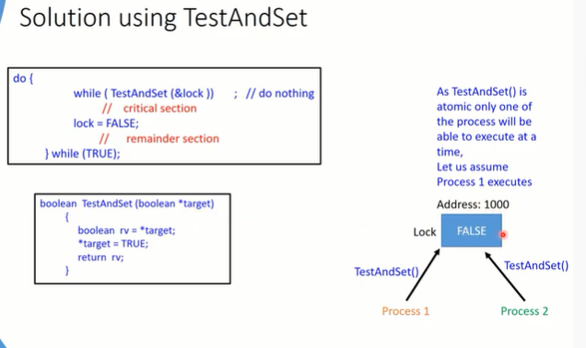

Slide 92
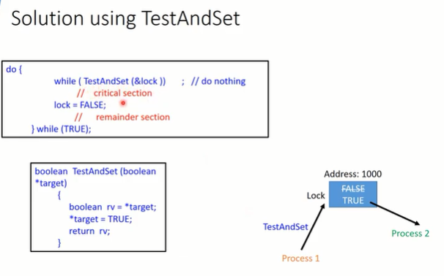

Slide 93
Solution using TestAndSet
Shared boolean variable lock., initialized to false.
Solution:
do {
while ( TestAndSet (&lock ))
; /* do nothing
// critical section
lock = FALSE;
// remainder section
} while ( TRUE);

Slide 94
TestAndndSet Instruction
Definition:
boolean TestAndSet (boolean *target)
{
boolean rv = *target;
*target = TRUE;
return rv:
}

Slide 95
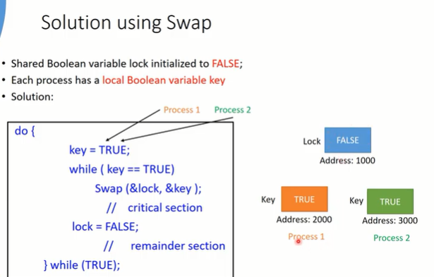

Slide 96
Solution using Swap
Shared Boolean variable lock initialized to FALSE; Each process has a local Boolean variable key.
Solution:
do {
key = TRUE;
while ( key == TRUE)
Swap (&lock, &key );
// critical section
lock = FALSE;
// remainder section
} while ( TRUE);

Slide 97
Swap Instruction
Definition:
void Swap (boolean *a, boolean *b)
{
boolean temp = *a;
*a = *b;
*b = temp:
}

Slide 98
Bounded –waiting mutual exclusion with TestAndSet
do {
waiting[i]=true;
key = true
while (waiting[i])&&key)
key= TestAnd Set(lock);
waiting[i]=false;
}
Critical Section
J=(i+1)%n;
While((j!=i)&&!waiting[j])
J=(j+1)%n;
If(j==i)
Lock=false;
Else
Waiting[j]=false;
Remainder section
}(1)

